Slide 1

Making a splash in the NBA
Notes:
Ryan

Slide 2
Introduction
NBA commissioner Adam Silver has accepted the Vancouver Whales proposal as the new expansion team for the 2021 season.
Stipulations:
No protected players, all players are available
Player’s salary will be equivale to last year’s salary
Only one starter and bench player for each position
Notes:
Ryan

Slide 3
Team Proposal
Elon Musk, the owner of the Vancouver whales, wants to assemble a winning team for the 2021 season. He has hired Lucy Luo, Ryan Worm, and Tom Nierodzik to assemble multiple rosters:
The Dream Team
Offensive Powerhouse
Defensive Powerhouse
The Money Ball
Vancouver Whales
Notes:
Ryan

Slide 4
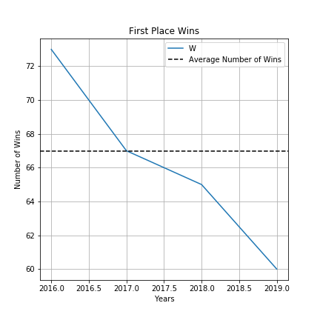
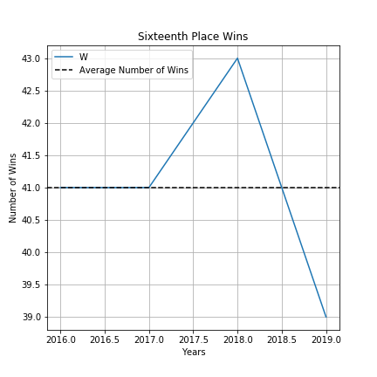
Qualifying success
The average number of wins required to get first place (regular season) is 67 wins based off the last five years.
The average number of wins required to get sixteenth place (last playoff position) is 41 wins over the last five years.
Notes:
Ryan

Slide 5
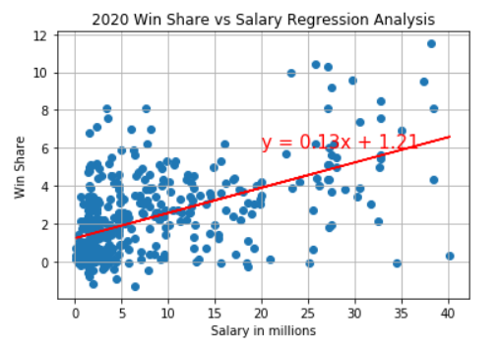
22020 Win Share Regression
Win shares is a metric that estimates the number of wins a player produces for his team throughout the season. Wins share is a combination of offensive win share and defensive win share.
There is a moderate correlation (0.55) between salary and win share , thus suggesting there is a positive correlation.
The calculated r-square value is 0.29, which means the line of best fit explains 30% of the data points
All teams will be designed and built with Win Share Statistics
Notes:
Lucy

Slide 6
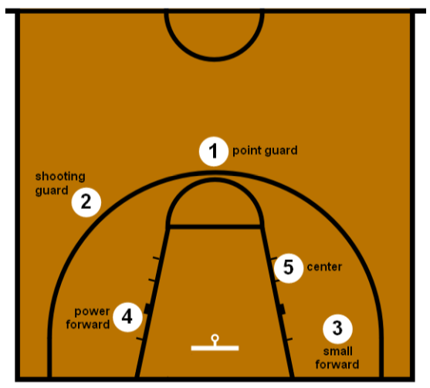
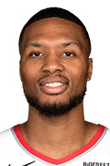

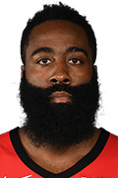

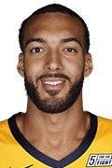
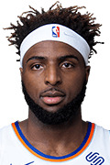
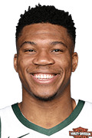
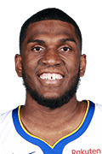
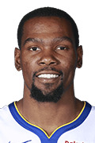

Dream Team
STARTER
BENCH
STARTER
BENCH
Built to dominate the league. Each player has the highest average win share for their position based off the last five seasons.
WS is a metric that estimates how many wins that player contributes individually over the course of a season.
D. Lillard
Avg WS: 10.78
G. Hill
Avg WS: 5.9
J. Harden
Avg WS: 14.8
F. VanVleet
WS: 4.7
STARTER
BENCH
STARTER
BENCH
R. Gobert
Avg WS: 10.64
M. Robinson
Avg WS: 6.8
G. Antetokounmpo
Avg WS: 11.24
K. Looney
Avg WS: 6.0
STARTER
BENCH
K. Durant
Avg WS: 12.10
G. Hayward
Avg WS: 5.0
Notes:
Tom

Slide 7

Offensive Power House
STARTER
BENCH
STARTER
BENCH
The offensive power house features the flashes players in the league. The team is strictly built on offense. This roster is made up of the top five players selected by highest average Offensive Win Shares (OWS) base off the last five seasons.
OWS measures the offensive contributions that player brings to their team as wins over the course of a regular season.
D. Lillard
Avg WS: 10.78
G. Hill
Avg WS: 5.9
J. Harden
Avg WS: 14.8
F. VanVleet
WS: 4.7
STARTER
BENCH
STARTER
BENCH
K. Towns
Avg WS: 10.10
M. Robinson
Avg WS: 6.8
G. Antetokounmpo
Avg WS: 11.24
K. Looney
Avg WS: 6.0
STARTER
BENCH
K. Durant
Avg WS: 12.10
G. Hayward
Avg WS: 5.0
Notes:
Tom

Slide 8
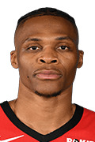

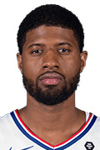
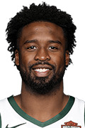
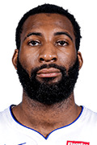

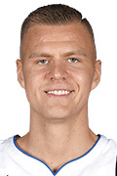

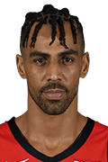
Defensive Power House
STARTER
BENCH
STARTER
BENCH
This team is the definition, defense wins championships. This team is built to stop offense and win games playing shut down basketball. This roster is built by selecting players with the highest average Defensive Win Shares (DWS) based off the last five season.
DWS measures the defensive contributions that player brings to their team as wins over the course of a regular season.
R. Westbrook
Avg WS: 9.66
E. Bledsoe
Avg WS: 5.38
P. George
Avg WS: 8.2
W. Matthews
Avg WS: 8.2
STARTER
BENCH
STARTER
BENCH
A. Drummond
Avg WS: 7.74
S. Adams
Avg WS: 7.6
G. Antetokounmpo
Avg WS: 11.24
K. Porzingis
Avg WS: 4.3
STARTER
BENCH
K. Leonard
Avg WS: 9.06
T. Sefolosha
Avg WS: 2.52
Notes:
tom

Slide 9
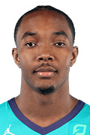
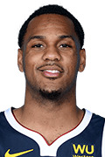



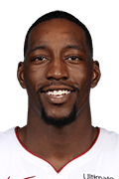
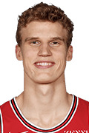

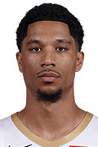
Money Ball
STARTER
BENCH
STARTER
BENCH
Built on the most team-friendly contract the league has to offer. This team is built by selecting the top players with the highest Win Shares/ ($) Million base on their 2020 salary.
Win Shares/($) Million = (win share)/ Salary
D. Graham
Avg WS: 3.4
M. Morris
Avg WS: 3.4
D. Robinson
Avg WS: 4.7
D.Lee
Avg WS: 1.7
STARTER
BENCH
STARTER
BENCH
J. Allen
Avg WS: 7.1
M. Robinson
Avg WS: 6.8
B. Adebayo
Avg WS: 8.1
L. Markkanen
Avg WS: 14.8
STARTER
BENCH
R. O`Neale
Avg. WS: 4.0
J. Hart
Avg. WS: 2.7
Notes:
tom

Slide 10
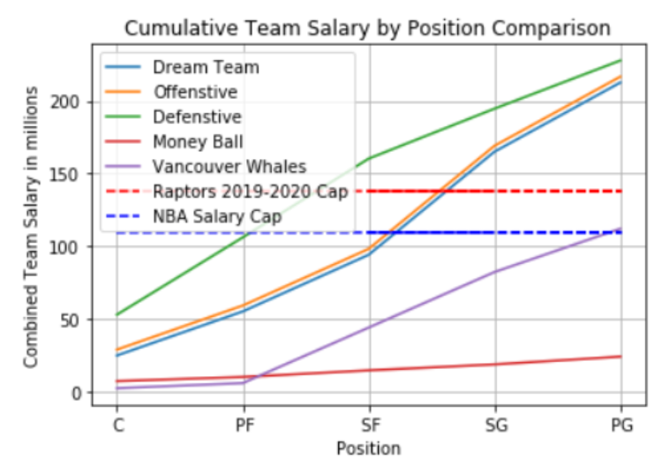
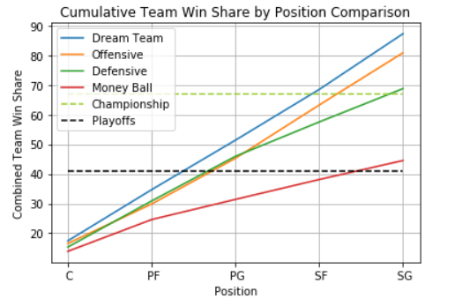
Summary Analysis
19.1
Wins
Notes:
Lucy

Slide 11
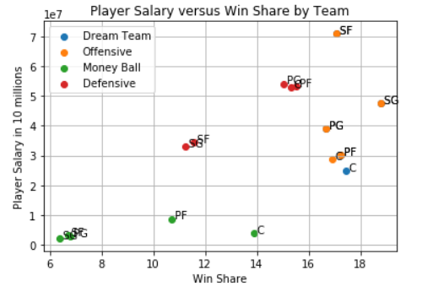
Recommendations
Notes:
lucy

Slide 12
Vancouver Whales
STARTER
BENCH
STARTER
BENCH
Replaced the least productive players on the money ball team with the best players (WS) from other teams to create the Vancouver Whales team.
The total salary is 112.03 mil and total win share is 69.36.
D. Lillard
Avg WS: 10.78
M. Morris
Avg WS: 3.4
J. Harden
Avg WS: 14.8
D.Lee
Avg WS: 1.7
STARTER
BENCH
STARTER
BENCH
J. Allen
Avg WS: 7.1
M. Robinson
Avg WS: 6.8
B. Adebayo
Avg WS: 8.1
L. Markkanen
Avg WS: 14.8
STARTER
BENCH
K. Durant
Avg WS: 12.10
J. Hart
Avg. WS: 2.7
Notes:
tom

Slide 13
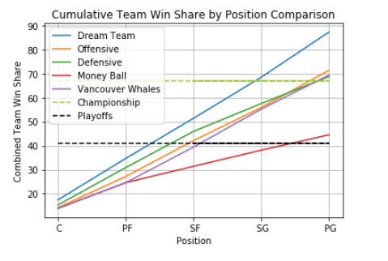
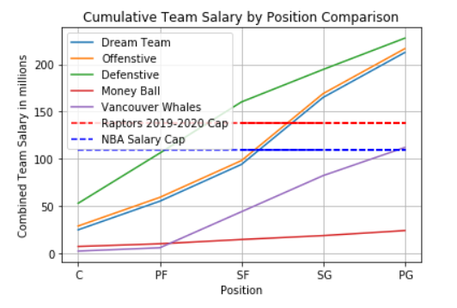
Summary Analysis The total salary is $112.03 million and total win share is 69.36
Notes:
The total salary is 112.03 mil and total win share is 69.36

Slide 14
Data Source and Cleansing Process
NBA API (https://pypi.org/project/nba-api/)
NBA API Github (https://github.com/swar/nba_api/tree/master/docs)
NBA Player Salary (http://www.espn.com/nba/salaries)
NBA Player/Team stats (https://www.basketball-reference.com/)
Merged player stats with active player lists and filtered for active players only
Grouped data frame by position and calculated average win share of each player in the past 5 seasons
Selected top player at each position based on average win share
Notes:
lucy

